Slide 1
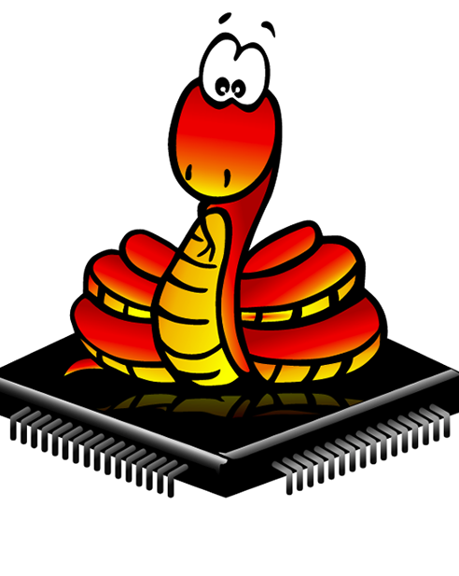

Micropython With ESP8266

Slide 2

What is MicroPython
MicroPython3 was created and is maintained by Damien P. George and other contributors. I
MicroPython aims to implement the Python 3.4 standard
it was designed to be a lean, efficient version of the Python 3 language
and installed on a small microcontroller.
MicroPython effectively functions like a small operating system, running user programs and providing a command interpreter (REPL).

Slide 3
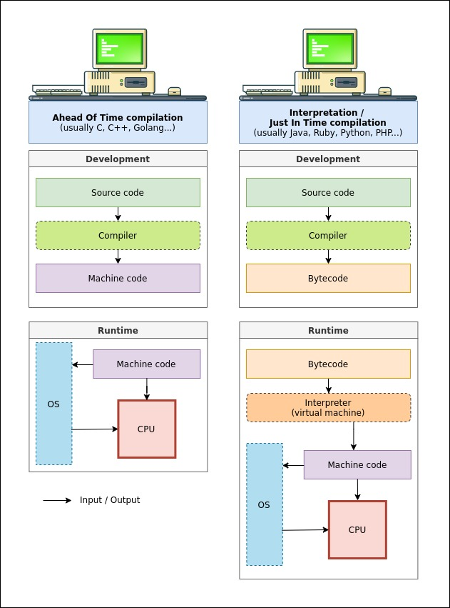
COMPILED VS. INTERPRETED

Slide 4
COMPILED
INTERPRETED
Computer
Computer
IDE editor
IDE editor
Source Code
ESP8266
Compiler
Source Code
Interpreter
ESP8266
Flash Memory
Flash Memory

Slide 5
MicroPython Features
Interactive Interpreter
by connecting with a USB cable (or in some cases over WiFi).
Python Standard Libraries
socket programming , Parsing JSON , string manipulation.
Hardware-Level Libraries
read analog digital data, and (PWM),SPI,UART,I2C ,ADC,Timer ,WDT,RTC.
Extensible
feature for advanced users to implement some complex library at a low level (in C or C++) and include the new library in MicroPython.

Slide 6
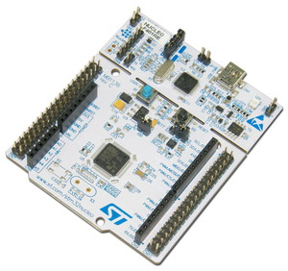
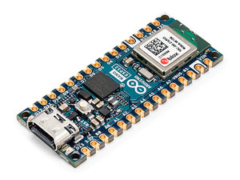

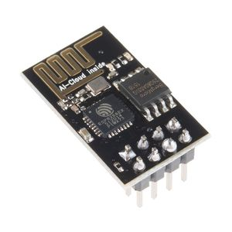
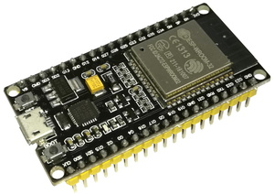
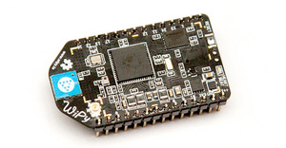
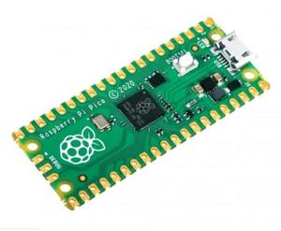
What Does MicroPython Run On?
teensy 4.0
Arduino nano esp32
Nucleo F401RE
ESP32
ESP8266
Pico
WiPy Module

Slide 7
The MicroPython Interactive Interpreter Mode (aka REPL)
An acronym for “Read, Eval, Print, Loop”.
This is the interactive Python prompt, useful for debugging or testing code.
a REPL available over a UART, and this is typically accessible on a host PC via USB.
1- Auto-indent
2- Auto-completion
3- Interrupting a running program

Slide 8
THANK YOU

